Slide 1
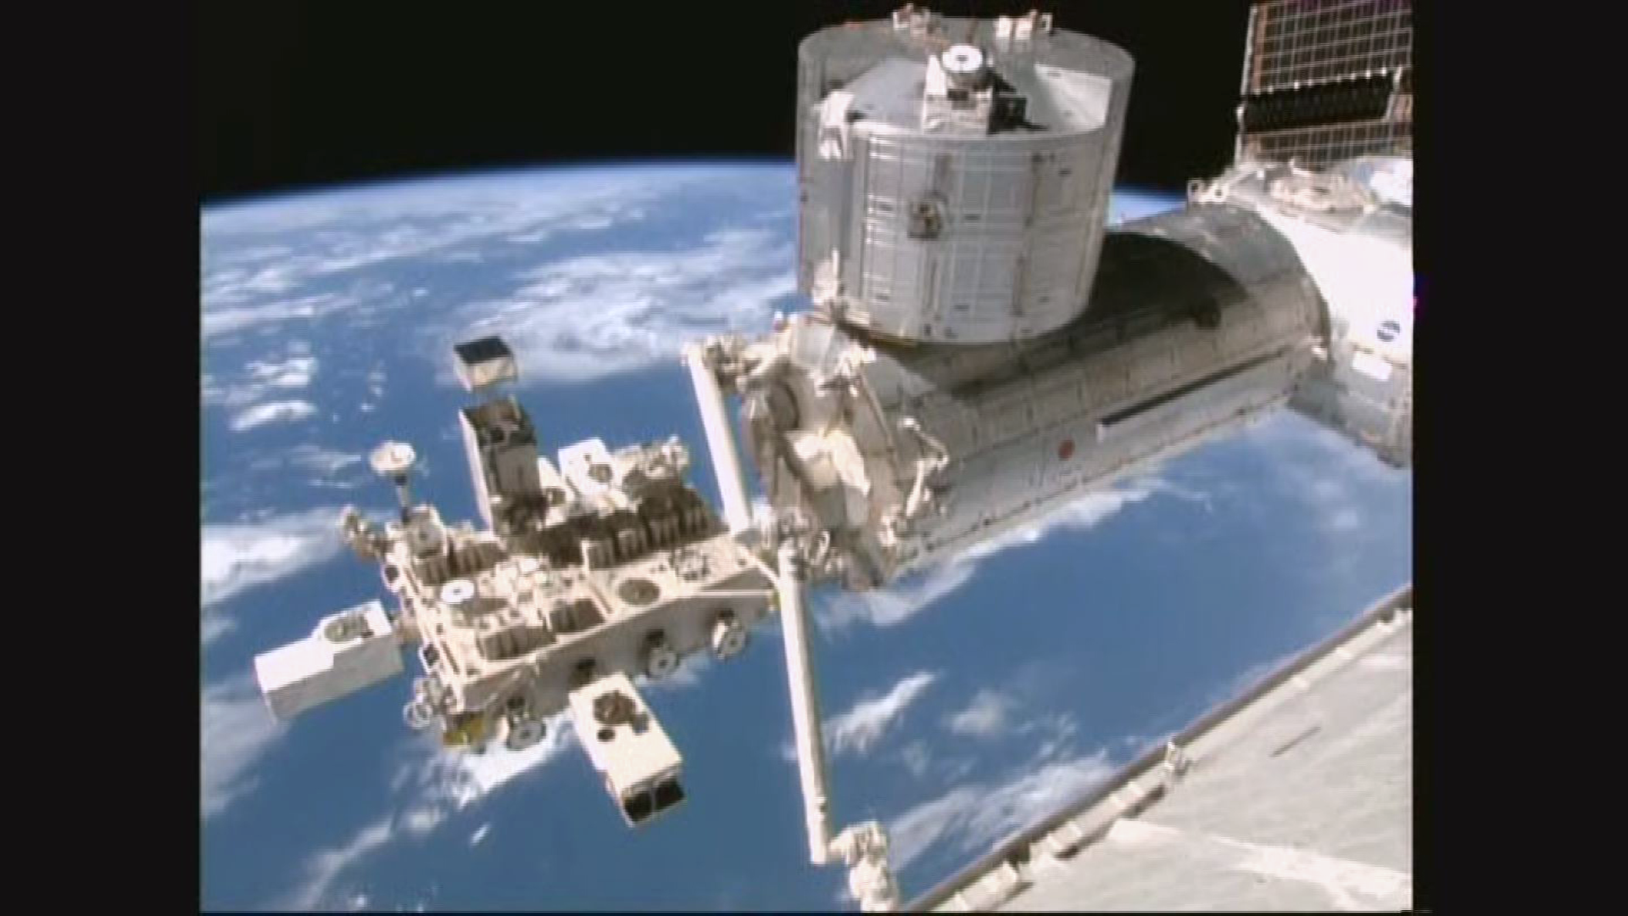

CALETによる10年間の太陽変調観測と
ドリフトモデルによる再現
OIST, 信大理^{A},早大理工総研^{B}, 東大宇宙線研^{C}
三宅 晶子, 宗像一起^{A} ，赤池陽水^{B} ，
小林兼好^{B} ，鳥居祥二^{B} ，片岡龍峰 ，
加藤千尋^{A} ，寺澤敏夫^{C}
他 CALETチーム

Slide 2
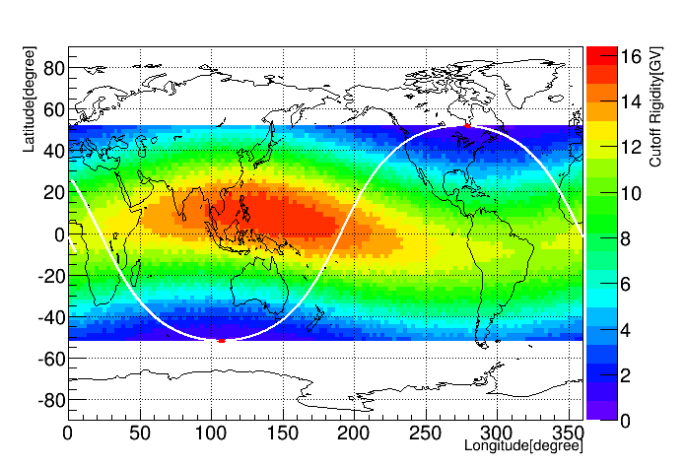
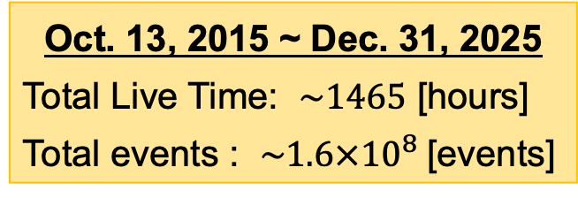
Measurements of Low-Energy CRs by the CALET
Low-energy e⁻ shower trigger mode (LEE Trigger):
Trigger threshold: shower energy > 1 GeV
The LEE trigger is enabled only in high-latitude regions
(geomagnetic cutoff rigidity < ~5.0 GV)
→ The LEE trigger is activated for 90 sec. twice per ISS orbit.
Cutoff rigidity map and ISS orbit
LEE trigger ON
CALET’s Observing Area
Oct. 13, 2015 ~ Dec. 31, 2025
Total Live Time: $\sim 1465$ [hours]
Total events : $\sim 1.6×{10}^{8}$[events]
LEE trigger ON
http://www.ngdc.noaa.gov/IAGA/vmod/igrf.html
Analyses of LEE-trigger data
All-electron (e⁻+e⁺) flux for each Carrington rotation
Electron and proton count rates at ~3.8 GV for investigating charge-sign dependence
Daily count rates (~3.8GV) for Forbush decrease studies
* The electron count rate was derived by assuming that the positron contamination followed the proton contamination and was normalized to a 7% positron fraction in November 2015 (CR 2170), based on the AMS-02 measurement.

Slide 3

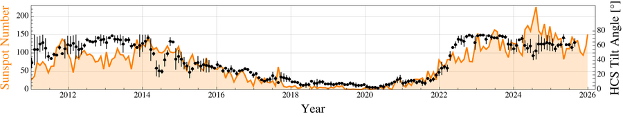
Recent Solar Cycle
Time profile of the polar field, sunspot number, and HCS tilt angle
Solar Cycle 25
A<0
A>0
A<0
CALET Experiment
Solar Cycle 25 began in December 2019, following the solar minimum.
Solar activity has rapidly increased since 2022, and the Sun's polar magnetic field has reversed from positive to negative.
→ The global solar magnetic polarity appears to have changed from A>0 to A<0.

Slide 4
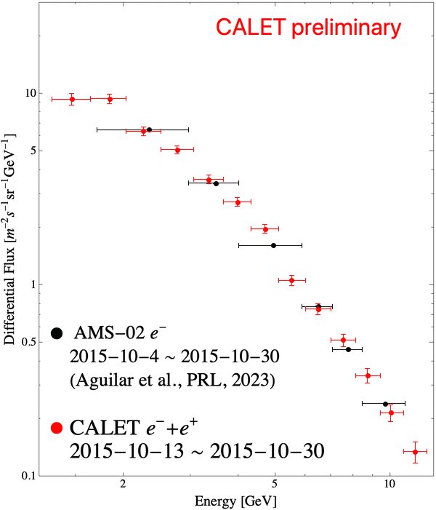
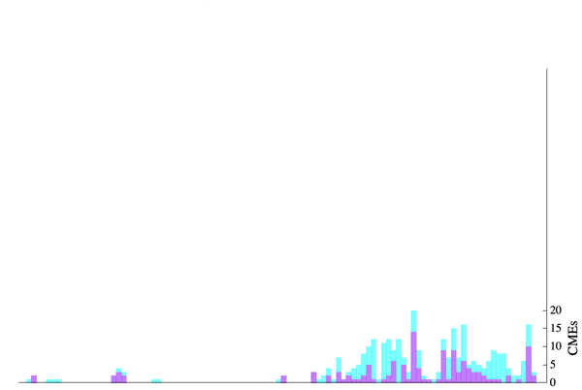
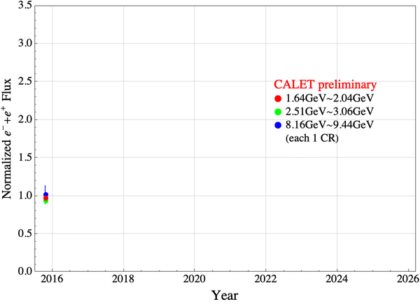
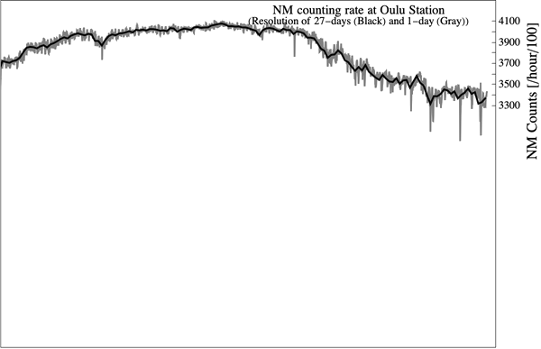

Long-Term Variation of the CR e⁻ + e⁺ Flux
The 1–10 GeV e⁻ + e⁺ flux began to decrease about six months after the beginning of Solar Cycle 25 (Dec. 2019) and eventually reached its lowest level during the observation period.
The e⁻ + e⁺ flux has remained low even after the magnetic polarity reversal, and no clear effect of the polarity reversal has been observed so far.
CR e⁻+e⁺ energy spectrum
Time profile of the CR e⁻+e⁺ flux
SoHo LASCO CME Catalog
■ $≥10$00km/s ■ $≥10$00km/s & halo CME

Slide 5
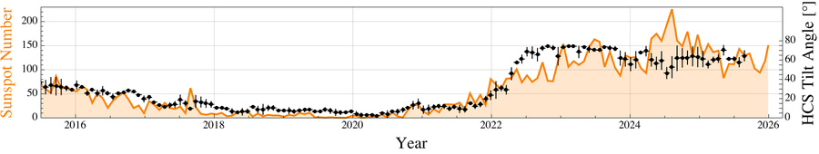
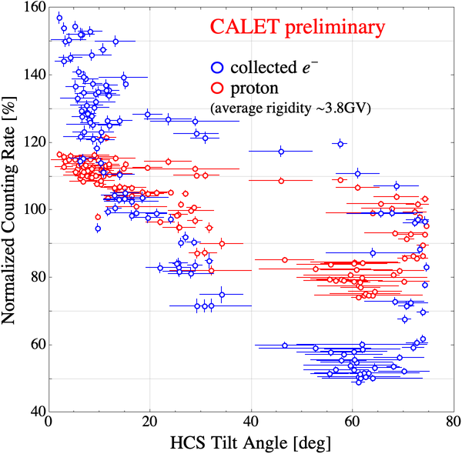
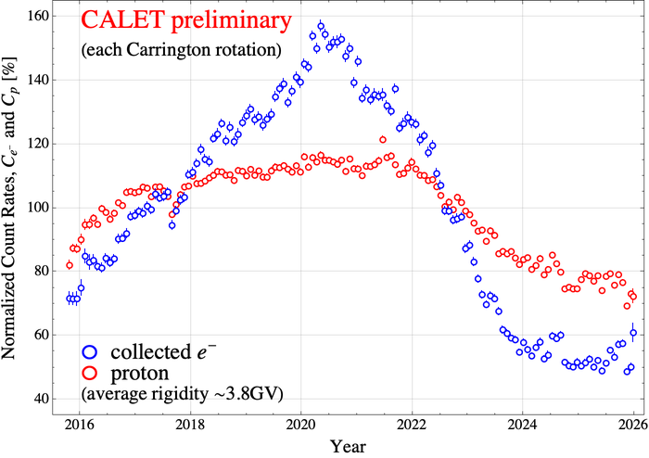
Charge-Sign Dependence of Solar Modulation
The proton count rate also reached its lowest level since the beginning of the CALET observations.
CALET observed a clear hysteresis loop between the CR intensity and the HCS tilt angle over the solar cycle.
Time profile of the CR proton and electron count rates
Correlation between the CR proton/electron count rates and HCS tilt angle
(This figure shows the results up to Sep. 2025 (CR2302), for which WSO’s HCS tilt angle data is publicly available.)
(Average value for the entire period is normalized to 100%)

Slide 6
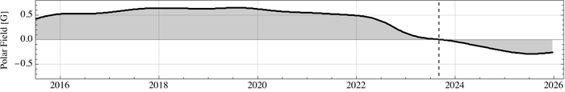
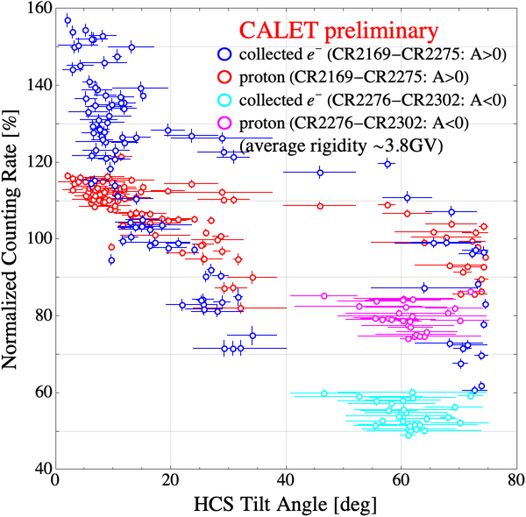
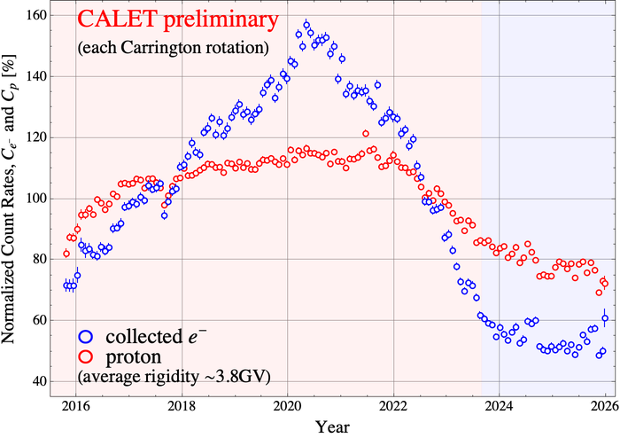
Charge-Sign Dependence of Solar Modulation
As the HCS tilt angle decreases, the effect of the magnetic polarity reversal is expected to become more apparent, and the characteristic time profile and hysteresis loop of the A<0 epoch are expected to emerge.
Time profile of the CR proton and electron count rates
Correlation between the CR proton/electron count rates and HCS tilt angle
(This figure shows the results up to Sep. 2025 (CR2302), for which WSO’s HCS tilt angle data is publicly available.)
(Average value for the entire period is normalized to 100%)

Slide 7
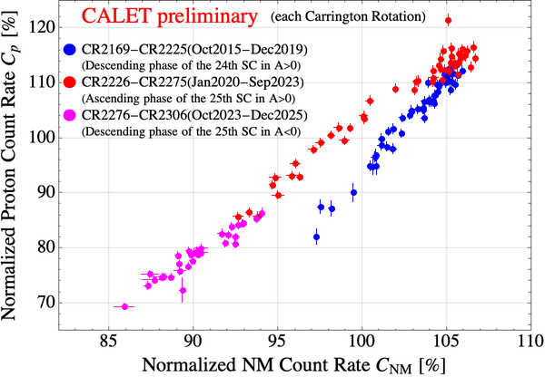
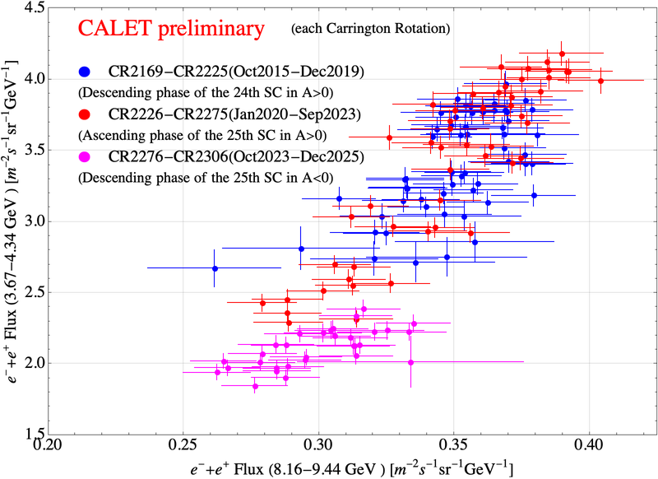
Rigidity Dependence
The proton rigidity dependence differs between the descending and ascending phases of the solar cycle. However, the post-reversal descending phase still follows the ascending-phase relationship, whereas no comparable difference is observed for electrons.
Correlation between count rates of ~3.8 GV protons and NM count rate
Correlation between ~4.0 GeV e⁻+e⁺ flux and ~8.8 GeV e⁻+e⁺ flux
(at Oule station)

Slide 8
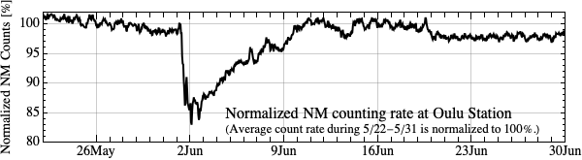
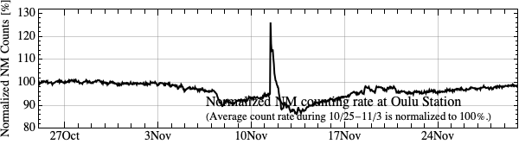
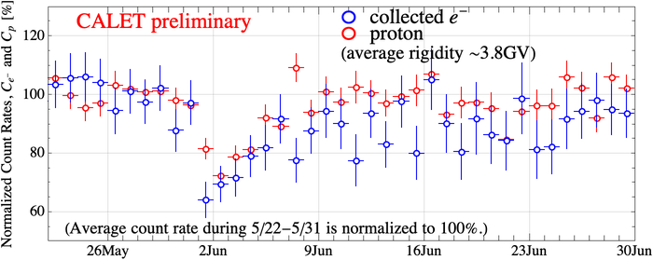
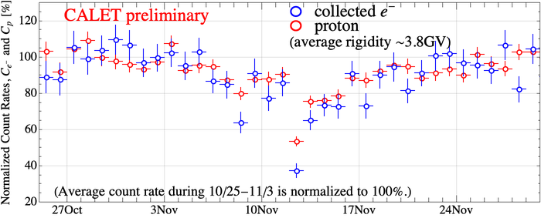
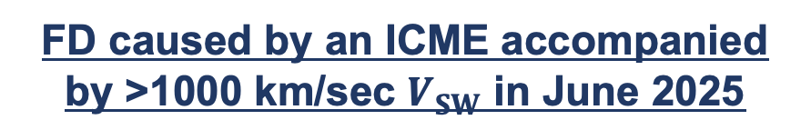









Forbush Decreases (FDs) of CR Protons and Electrons
The June and November 2025 events also suggest electron–proton differences in amplitude and/or timing.
These preliminary results indicate event-to-event diversity in the electron and proton responses to FDs.
FD caused by an ICME accompanied by >1000 km/sec $V_{SW}$ in June 2025
FD with a strong GLE (ground level enhancement) in Nov. 2025
$$\sim −15\%$$
$$\sim −15\%$$
$$\sim −10\%$$
$$\sim −30\%$$
$$\sim −20\%$$
$$\sim −35\%$$
$$\sim −25\%$$
$$\sim −40\%$$
$$\sim −30\%$$
( Note: Error bars show statistical uncertainties only; systematic uncertainties are under evaluation.)
Notes:
The June and November 2025 events show additional examples of the diversity of Forbush decreases.
In both events, the electron and proton count rates decrease at approximately the same time, but the amplitudes of the decreases are different.
In November, the CALET decrease timing differed from the neutron-monitor observation, and the GLE seen by the neutron monitor was not evident in CALET.
These preliminary results suggest event-dependent differences between the electron and proton responses to Forbush decreases.
However, the error bars shown here include only statistical uncertainties, and further improvements in the daily analysis and evaluation of systematic uncertainties are still in progress.

Slide 9
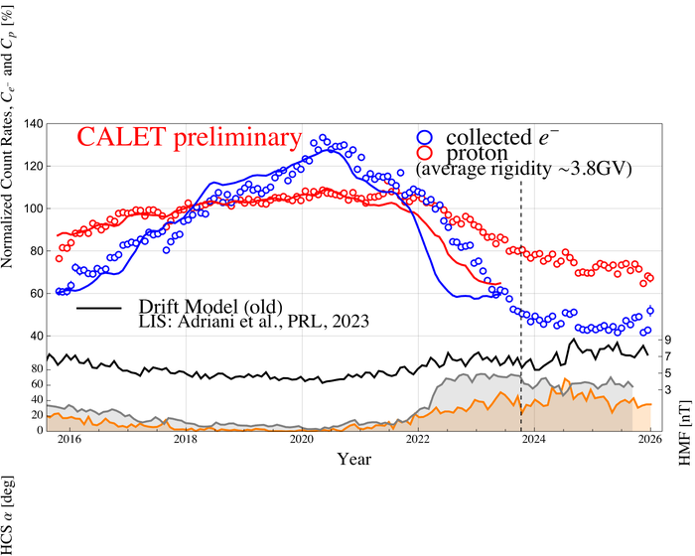
Previous Drift Model Validation with CALET observations
We succeeded to reproduce the observed charge-sign dependence for the descending phase of the solar cycle (Adriani et al., PRL, 2023).
However, this model fails to reproduce that for the ascending phase of the solar cycle (presented at the JPS fall meeting in 2023).
Time profile of the CR proton and electron count rates

Slide 10
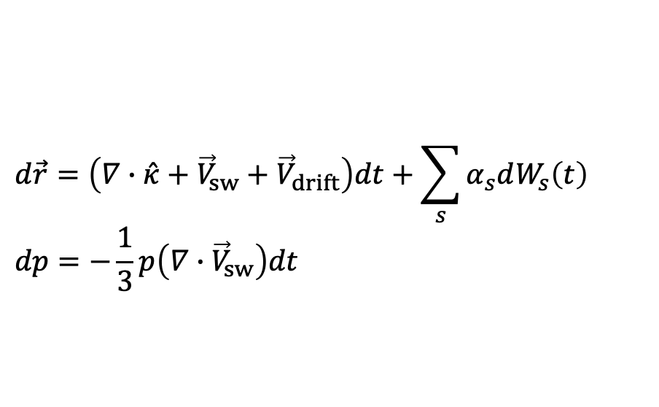
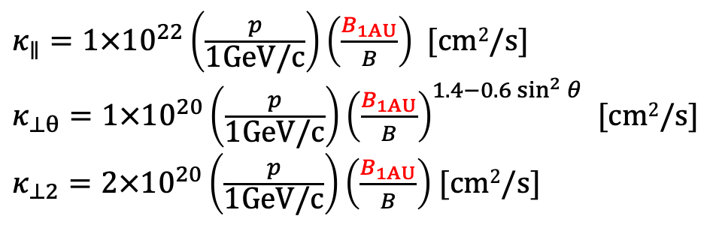
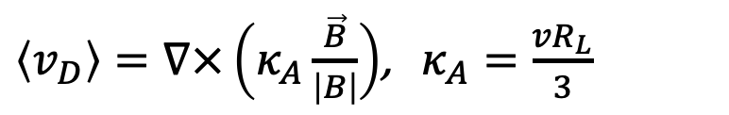
Previous Drift Model: GCR Transport
Stochastic differential equation (SDE)
Drift motion
$$d\vec{r}=\left(∇∙\hat{κ}+{\vec{V}}_{sw}+{\vec{V}}_{drift}\right)dt+\sum_{s}{α_{s}dW_{s}\left(t\right)}$$
$$dp=−\frac{1}{3}p\left(∇∙{\vec{V}}_{sw}\right)dt$$
$\left\langle v_{D}\right\rangle =∇×\left(κ_{A}\frac{\vec{B}}{\left|B\right|}\right)$, $κ_{A}=\frac{vR_{L}}{3}$
HCS drift velocity:
approximation function based on distance from the HCS (Burger and Potgieter, 1989)
If the distance between the sheets becomes less than the gyro-radius of pseudo particle, the HCS drift velocity is reduced accordingly.
Diffusion coefficient
$κ_{∥}=1×{10}^{22}\left(\frac{p}{\text{1GeV/}\text{c}}\right)\left(\frac{B_{1AU}}{B}\right)$ [cm²/s]
$κ_{⊥θ}=1×{10}^{20}\left(\frac{p}{\text{1GeV/}\text{c}}\right){\left(\frac{B_{1AU}}{B}\right)}^{1.4−0.6\sin^{2}{θ}}$ [cm²/s]
$κ_{⊥2}=2×{10}^{20}\left(\frac{p}{\text{1GeV/}\text{c}}\right)\left(\frac{B_{1AU}}{B}\right)$ [cm²/s]

Slide 11
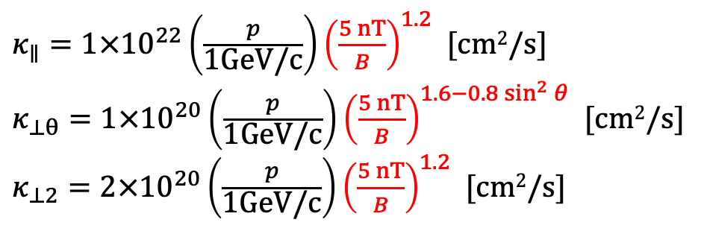
New Drift Model: GCR Transport
Stochastic differential equation (SDE)
Drift motion
$$d\vec{r}=\left(∇∙\hat{κ}+{\vec{V}}_{sw}+{\vec{V}}_{drift}\right)dt+\sum_{s}{α_{s}dW_{s}\left(t\right)}$$
$$dp=−\frac{1}{3}p\left(∇∙{\vec{V}}_{sw}\right)dt$$
$\left\langle v_{D}\right\rangle =∇×\left(κ_{A}\frac{\vec{B}}{\left|B\right|}\right)$, $κ_{A}=\frac{vR_{L}}{3}$
HCS drift velocity:
approximation function based on distance from the HCS (Burger and Potgieter, 1989)
If the distance between the sheets becomes less than the gyro-radius of pseudo particle, the HCS drift velocity is reduced accordingly.
Diffusion coefficient
$κ_{∥}=1×{10}^{22}\left(\frac{p}{\text{1GeV/}\text{c}}\right){\left(\frac{5 nT}{B}\right)}^{1.2}$ [cm²/s]
$κ_{⊥θ}=1×{10}^{20}\left(\frac{p}{\text{1GeV/}\text{c}}\right){\left(\frac{5 nT}{B}\right)}^{1.6−0.8\sin^{2}{θ}}$ [cm²/s]
$κ_{⊥2}=2×{10}^{20}\left(\frac{p}{\text{1GeV/}\text{c}}\right){\left(\frac{5 nT}{B}\right)}^{1.2}$ [cm²/s]

Slide 12
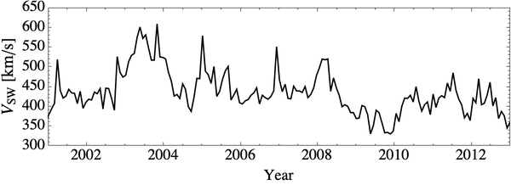
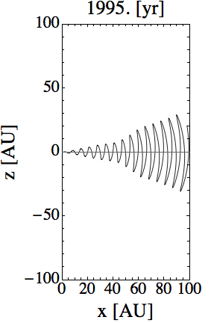
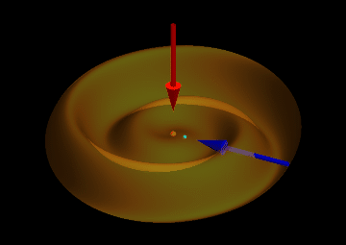
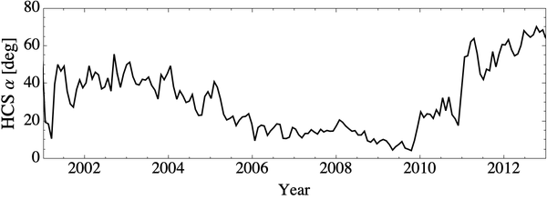
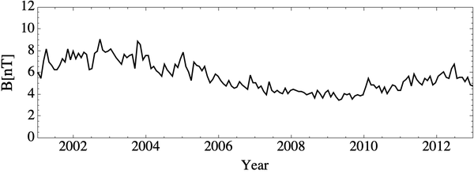
New Drift Model: Heliosphere
Solar wind and magnetic field
Solar wind and HMF near the Earth
(OMNI Web, WSO)
Heliosheric Current Sheet (HCS)
Isotropic solar wind speed.
Standard Parker spiral heliospheric magnetic field (HMF).
Variations of the observed solar-wind speed and HMF (referring to NASA/Goddard Space Flight Center, OMNIweb).
Radial dependent tilt angle of the heliospheric current sheet (HCS).
Solar wind speed
p
HCS tilt angle
A>0
e-
HMF strength
Heliosphere and heliosheath
Solar wind and HMF in the near the HTS
Global Heliosphere
(Burlaga et al., ApJ, 2009)
Bubble-like structures of the heliosphere (85 AU) and heliosheath (120AU).
In the heliosheath, the solar wind speed (the magnetic strength) is reduced to 1/2.6 (increased to 2.5 times) of that in the heliosphere (Burlaga et al., ApJ, 2009).
Helioshere
120AU
85AU
Heliosheath

Slide 13
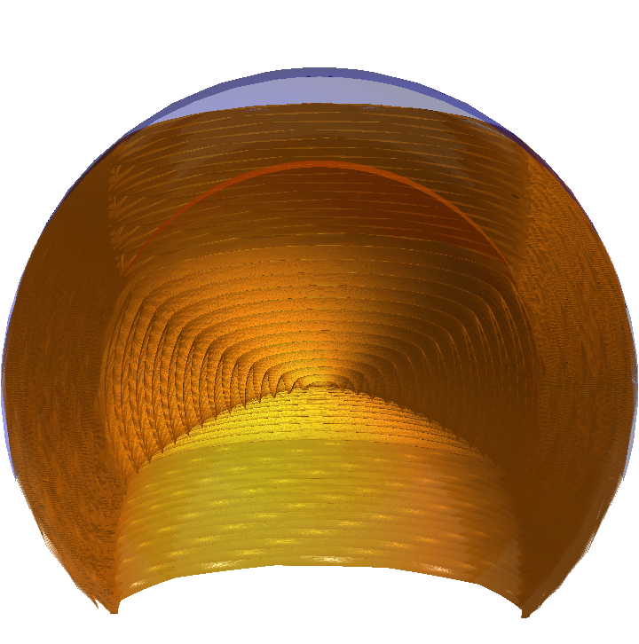
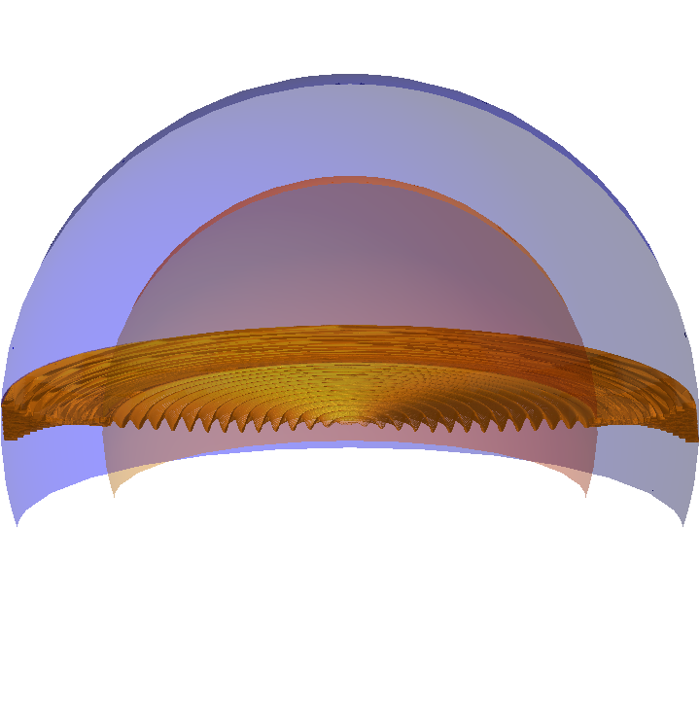
New Drift Model: Heliosphere
Solar wind and magnetic field
HCS for descending phase
HCS for ascending phase
Isotropic solar wind speed.
Standard Parker spiral heliospheric magnetic field (HMF).
Variations of the observed solar-wind speed and HMF (referring to NASA/Goddard Space Flight Center, OMNIweb).
Radial dependent tilt angle of the heliospheric current sheet (HCS).
(HCS tilt angle at 1 AU is assumed to be 10 degrees.)
Heliosphere and heliosheath
Solar wind and HMF in the near the HTS
Global Heliosphere
(Burlaga et al., ApJ, 2009)
Bubble-like structures of the heliosphere (85 AU) and heliosheath (120AU).
In the heliosheath, the solar wind speed (the magnetic strength) is reduced to 1/2.6 (increased to 2.5 times) of that in the heliosphere (Burlaga et al., ApJ, 2009).
Helioshere
120AU
85AU
Heliosheath

Slide 14
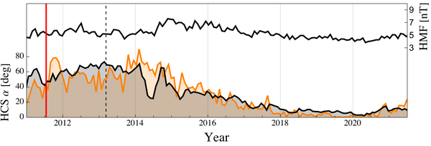
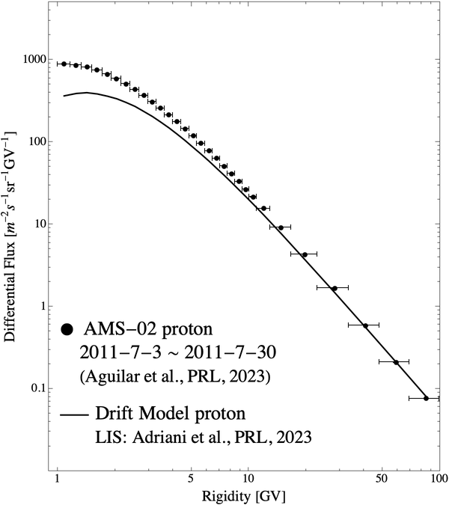
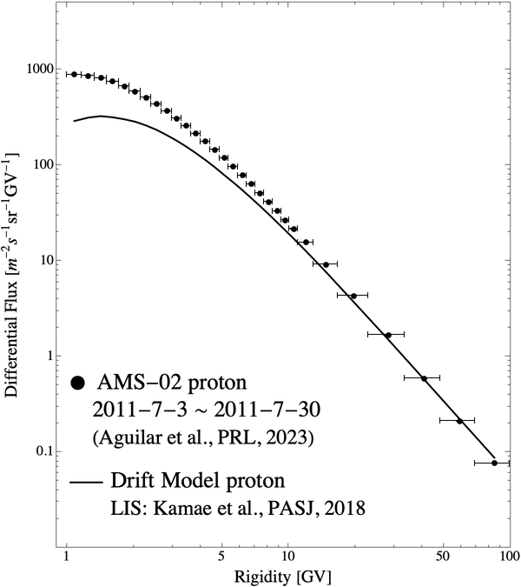
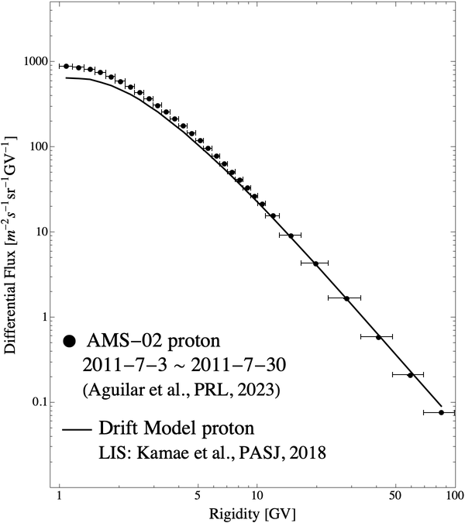
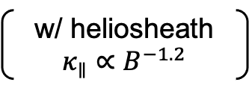
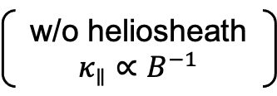
Model Refinement : Proton Spectrum
Comparison with proton spectra observed by AMS-02
Previous model
with Heliosheath
(+ LIS refinement)
New model
w/o heliosheath
$κ_{∥}∝B^{−1}$
w/ heliosheath
$κ_{∥}∝B^{−1.2}$

Slide 15

Model Refinement : Proton Spectrum
Comparison with proton spectra observed by AMS-02
Previous model
with Heliosheath
(+ LIS refinement)
New model
w/o heliosheath
$κ_{∥}∝B^{−1}$
w/ heliosheath
$κ_{∥}∝B^{−1.2}$

Slide 16
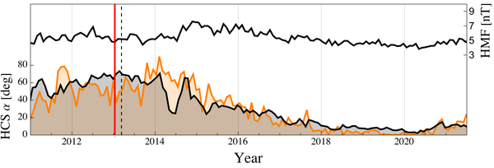
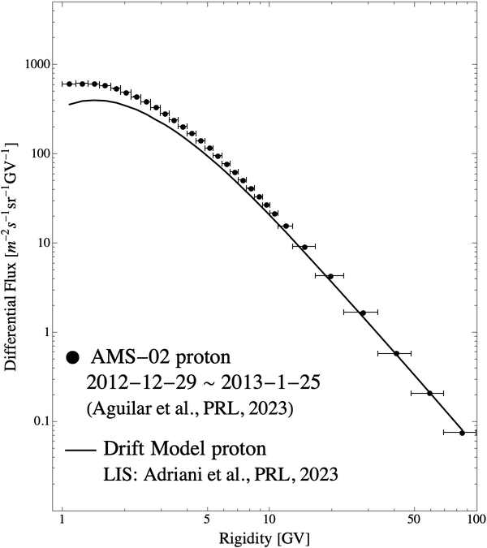
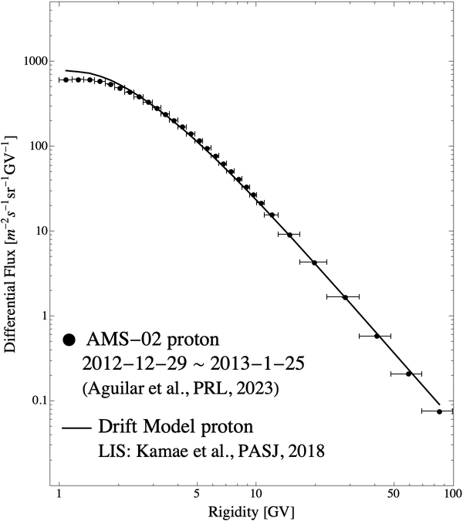


Model Refinement : Proton Spectrum
Comparison with proton spectra observed by AMS-02
Previous model
New model
w/o heliosheath, $κ_{∥}∝B^{−1}$
w/ heliosheath , $κ_{∥}∝B^{−1.2}$

Slide 17
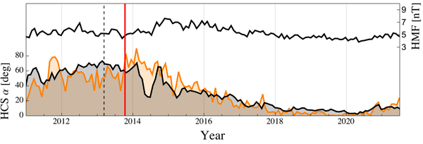
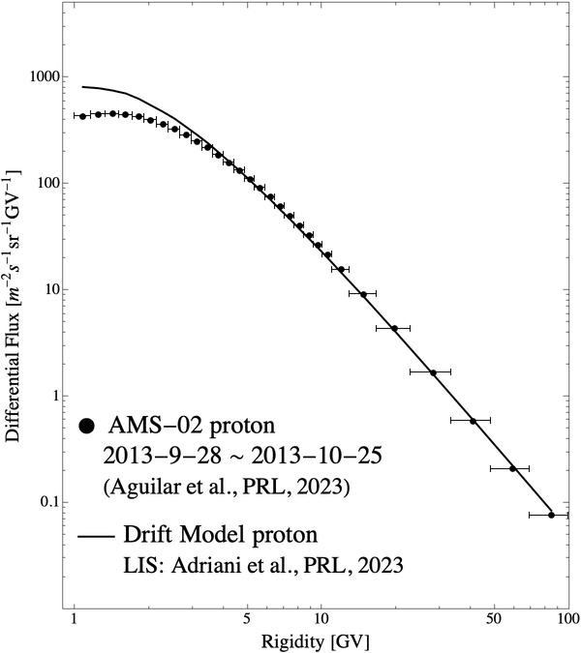

Model Refinement : Proton Spectrum
Comparison with proton spectra observed by AMS-02
Previous model
New model
w/o heliosheath, $κ_{∥}∝B^{−1}$
w/ heliosheath , $κ_{∥}∝B^{−1.2}$

Slide 18



Model Refinement : Proton Spectrum
Comparison with proton spectra observed by AMS-02
Previous model
New model
w/o heliosheath, $κ_{∥}∝B^{−1}$
w/ heliosheath , $κ_{∥}∝B^{−1.2}$

Slide 19
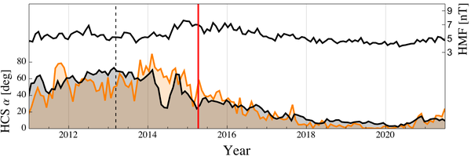


Model Refinement : Proton Spectrum
Comparison with proton spectra observed by AMS-02
Previous model
New model
w/o heliosheath, $κ_{∥}∝B^{−1}$
w/ heliosheath , $κ_{∥}∝B^{−1.2}$

Slide 20



Model Refinement : Proton Spectrum
Comparison with proton spectra observed by AMS-02
Previous model
New model
w/o heliosheath, $κ_{∥}∝B^{−1}$
w/ heliosheath , $κ_{∥}∝B^{−1.2}$

Slide 21
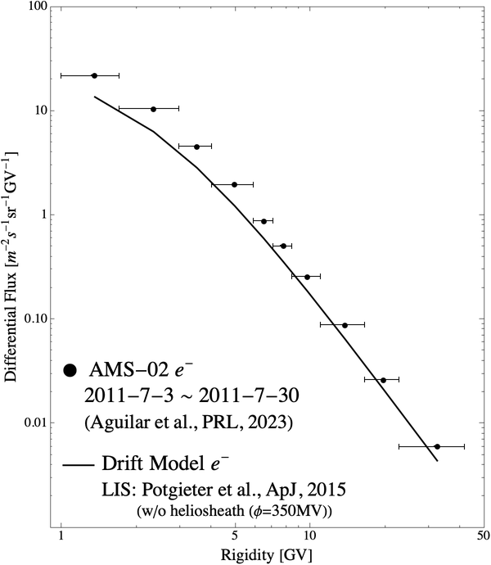
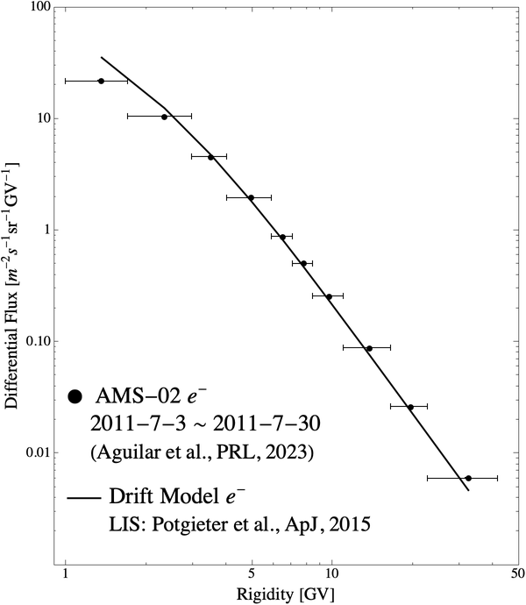
Model Refinement : Electron Spectrum
Comparison with electron spectra observed by AMS-02
Previous model
New model
w/o heliosheath, $κ_{∥}∝B^{−1}$
w/ heliosheath , $κ_{∥}∝B^{−1.2}$

Slide 22

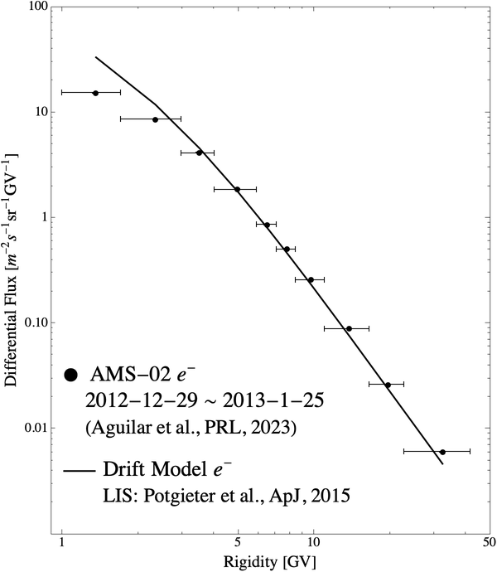
Model Refinement : Electron Spectrum
Comparison with electron spectra observed by AMS-02
Previous model
New model
w/o heliosheath, $κ_{∥}∝B^{−1}$
w/ heliosheath , $κ_{∥}∝B^{−1.2}$

Slide 23
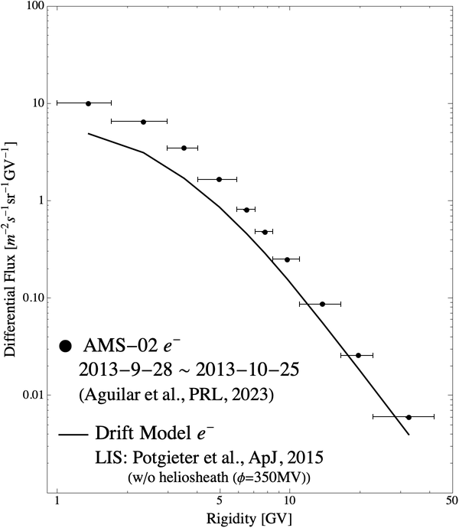
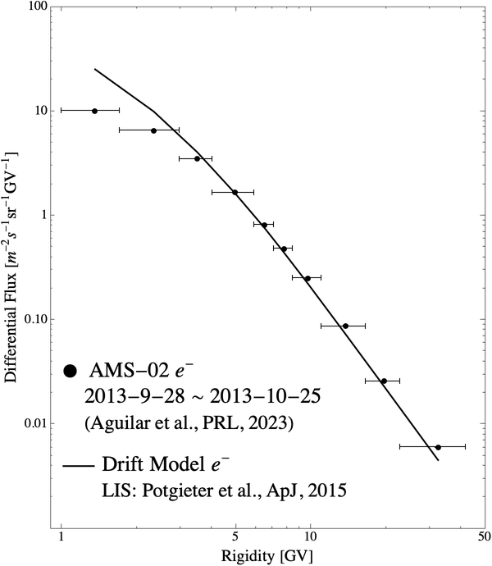
Model Refinement : Electron Spectrum
Comparison with electron spectra observed by AMS-02
Previous model
New model
w/o heliosheath, $κ_{∥}∝B^{−1}$
w/ heliosheath , $κ_{∥}∝B^{−1.2}$

Slide 24


Model Refinement : Electron Spectrum
Comparison with electron spectra observed by AMS-02
Previous model
New model
w/o heliosheath, $κ_{∥}∝B^{−1}$
w/ heliosheath , $κ_{∥}∝B^{−1.2}$

Slide 25


Model Refinement : Electron Spectrum
Comparison with electron spectra observed by AMS-02
Previous model
New model
w/o heliosheath, $κ_{∥}∝B^{−1}$
w/ heliosheath , $κ_{∥}∝B^{−1.2}$

Slide 26



Time profile of the CR proton and electron count rates
Previous model
New model
w/o heliosheath, $κ_{∥}∝B^{−1}$
w/ heliosheath , $κ_{∥}∝B^{−1.2}$
A>0
A<0

Slide 27


Time profile of the CR proton and electron count rates
Previous model
New model
w/o heliosheath, $κ_{∥}∝B^{−1}$
w/ heliosheath , $κ_{∥}∝B^{−1.2}$
A>0
A<0
A>0
A<0

Slide 28


Rigidity Dependence of the GCR Proton modulation
Previous model
New model
w/o heliosheath, $κ_{∥}∝B^{−1}$
w/ heliosheath , $κ_{∥}∝B^{−1.2}$

Slide 29
Summary
Results of the CALET observation
CALET has continuously observed galactic cosmic rays over one solar cycle, covering the solar minimum, maximum, and magnetic polarity reversal.
The 1–10 GeV all-electron flux continuously decreased after the beginning of Solar Cycle 25, reaching the lowest level observed by CALET, with no clear signature of the magnetic polarity reversal so far.
Charge-sign-dependent modulation is clearly observed, including hysteresis with the HCS tilt angle.
The proton rigidity dependence differs between the descending and ascending phases of the solar cycle. At present, however, the post-reversal descending phase still follows the ascending-phase relationship, whereas no comparable difference is observed for electrons.
CALET detected a variety of Forbush-decrease profiles, with preliminary indications of event-dependent differences between electron and proton responses.
Results of the drift model validation
We updated the drift model by considering the HMF dependence on the diffusion coefficient and a modulation in the heliosheath. However, the model still fails to reproduce the modulation during the ascending phase of the solar cycle and the rigidity dependence of proton modulation.
Long-term CALET observations are valuable for constraining numerical models of solar modulation.
Notes:
To summarize, CALET has now observed almost one full solar cycle, including the recent polarity reversal. We clearly observe charge-sign-dependent solar modulation, and continued observations during the A<0 epoch will provide a unique opportunity to study its long-term evolution. Thank you very much for your attention.
---
To summarize, CALET has continuously observed galactic cosmic rays over approximately one solar cycle, covering the solar minimum, maximum, and magnetic polarity reversal.
The one-to-ten-GeV all-electron flux decreased during Solar Cycle 25 and reached the lowest level observed by CALET, with no clear signature of the magnetic polarity reversal so far.
We observed clear charge-sign-dependent long-term modulation, including hysteresis with the HCS tilt angle.
The rigidity dependence is also different between protons and electrons, and the post-reversal proton data currently remain on the ascending-phase relationship.
CALET has also detected a variety of Forbush-decrease profiles, with preliminary indications of event-dependent differences between electron and proton responses.
Continued observations during the A-negative epoch will provide a unique opportunity to investigate the full response of galactic cosmic rays to the magnetic polarity reversal.
Thank you very much for your attention.

Slide 30
Buckup

Slide 31


How to calculate the collected e⁻ count rate
The electron count rate was derived by subtracting the estimated positron contribution from the all-electron count rate.
The positron contamination was assumed to vary in the same manner as the proton contamination.
The estimated positron contamination was normalized to give a positron fraction of 7% in November 2015 (CR 2170), based on the AMS-02 measurement.
Time profile of e⁻ + e⁺ and e⁻ count rates
Time profile of proton and e⁺ contaminations
normalized to e⁺ fraction of 7%
● e⁻ + e⁺
● collected e⁻

Slide 32



Correlation with various Heliospheric parameters
Among the heliospheric parameters examined, the HCS tilt angle shows the clearest hysteresis loop.
vs. HCS tilt angle
vs. SSN
vs. HMF magnitude
vs. SW speed
Notes:
We also compared the cosmic-ray count rates with several heliospheric parameters in addition to the HCS tilt angle: sunspot number, HMF magnitude, and solar-wind speed.
Among these parameters, the HCS tilt angle shows the clearest hysteresis loop.
Such a hysteresis structure reflects a time lag between solar activity and cosmic-ray modulation.
A more detailed discussion of the charge-sign-dependent time lag will be given by Professor Munakata in the related ST06 session on August fifth.

Slide 33

Comparison with electron and proton flux observed by AMS-02
New model
w/ heliosheath , $κ_{∥}∝B^{−1.2}$

Slide 34


Time profile of the CR proton and electron count rates
Previous model
New model (further modified)
w/o heliosheath, $κ_{∥}∝B^{−1}$
w/ heliosheath , $κ_{∥}∝B^{−1.2}$ , $κ∝R^{1.5}$

Slide 35


Rigidity Dependence of the GCR Proton modulation
Previous model
New model
New model (further modified)
w/o heliosheath, $κ_{∥}∝B^{−1}$
w/ heliosheath , $κ_{∥}∝B^{−1.2}$
w/ heliosheath , $κ_{∥}∝B^{−1.2}$ , $κ∝R^{1.5}$

Slide 36




Discussion about the rigidity dependence of the GCR Proton modulation
The period during which the magnetic polarity reversal propagates through the heliosphere and heliosheath.

Slide 37


Rigidity Dependence: Comparison with AMS-02 Observation
Despite the opposite polarity transitions, CALET and AMS-02 show a similar qualitative feature: two distinct branches for protons, but much weaker branch separation for electrons.
This behavior may primarily reflect the different spectral shapes of the proton and electron LIS.
Protons (CALET)
polarity transition:
qA>0 → qA<0
Electrons (CALET)
polarity transition:
qA<0 → qA>0
Protons (AMS-02)
polarity transition:
qA<0 → qA>0
Electrons (AMS-02)
polarity transition:
qA>0 → qA<0

Slide 38




Rigidity Dependence: Comparison with AMS-02 Observation

Slide 39


Long-Term Variation of the CR e⁻ + e⁺ Flux
The 1–10 GeV e⁻ + e⁺ flux began to decrease about six months after the beginning of Solar Cycle 25 (Dec. 2019) and eventually reached its lowest level during the observation period.
The e⁻ + e⁺ flux has remained low even after the magnetic polarity reversal, and no clear effect of the polarity reversal has been observed so far.
CR e⁻+e⁺ energy spectrum
Time profile of the CR e⁻+e⁺ flux

