Slide 1


CALETガンマ線観測による
銀河中心領域からの
暗黒物質信号の探査
23aW2-10
Probing the Galactic Center Region for Signatures of Dark Matter with CALET Gamma-ray Data
立命館大理工, Washington Univ. St. Louis^{A},
Louisiana State Univ.^{B}, 早大理工総研^{C}, 他CALETチーム
森 正樹, A. Coleman^{A}, B. Rauch^{A}, M. Negro^{B},
鳥居祥二^{C} , 他CALETチーム
Masaki Mori, for the CALET collaboration
日本物理学会2026年春季大会（オンライン）2026年4月23～26日

Slide 2




The CALET Collaboration
as of Jun 12 28, 2025
O. Adriani,^{1,2} Y. Akaike,^{3,4} K. Asano,⁵ Y. Asaoka,⁵ E. Berti,^{2,6} P. Betti, ^{2,6} G. Bigongiari,^{7,8} W.R. Binns,⁹
M. Bongi,^{1,2} P. Brogi,^{7,8} A. Bruno,¹⁰ N. Cannady,¹¹ G. Castellini,⁶ C. Checchia,^{7,8} M.L. Cherry,¹² A. Coleman,9 G.Collazuol,^{13,14} G.A. de Nolfo,¹⁰ K. Ebisawa,¹⁵ A. W. Ficklin,¹² H. Fuke,¹⁵ S. Gonzi,^{1,2,6}
T.G. Guzik,¹² T. Hams,¹⁶ K.Hibino,¹⁷ M. Ichimura,¹⁸ M.H.Israel,⁹ K. Kasahara,¹⁹ J. Kataoka,²⁰ R. Kataoka,²¹
Y. Katayose,²² C. Kato,²³ N. Kawanaka,^{24,25} Y. Kawakubo,²⁶ K. Kobayashi,^{3,4} K. Kohri,^{25,27}
H.S. Krawczynski, ⁹ J.F. Krizmanic,¹¹ P. Maestro,^{7,8} P.S. Marrocchesi,^{7,8} M. Mattiazzi,^{13,14} A.M.Messineo,^{8,28}
J.W. Mitchell,¹¹ S. Miyake,²⁹ A.A. Moiseev, ^{11,30,31} M. Mori,³² N. Mori,² H.M. Motz,³³ K. Munakata,²³
S. Nakahira,¹⁵ J.Nishimura,¹⁵ M.Negro,¹² S. Okuno,¹⁷ J.F. Ormes,³⁴ S. Ozawa,³⁵ L. Pacini,^{2,6} P. Papini,²
B.F. Rauch,⁹ S.B. Ricciarini,^{2,6} K. Sakai,³⁶ T. Sakamoto,²⁶ M. Sasaki, ^{11,30,31} Y. Shimizu,¹⁷ A. Shiomi,³⁷
PI: Japan
P. Spillantini,¹ F. Stolzi,^{7,8} S. Sugita,²⁶ A. Sulaj, ^{7,8} M.Takita,⁵ T.Tamura,¹⁷ T.Terasawa,⁵
S.Torii,³
Co-PI:
Co-PI:
Italy USA
Y.Tsunesada,^{38,39} Y.Uchihori,⁴⁰ E. Vannuccini,² J.P.Wefel,¹² K.Yamaoka,⁴¹ S.Yanagita,⁴² A.Yoshida,²⁶ K.Yoshida,¹⁹ and W. V. Zober ⁹
University of Florence, Italy
INFN Florence, Italy
WISE, Waseda University, Japan
Space Environment Utilization Center, JAXA, Japan
ICRR, University of Tokyo, Japan
IFAC, CNR, Italy
University of Siena, Italy
INFN Pisa, Italy
Washington University, St. Louis, USA
Heliospheric Physics Laboratory, NASA/GSFC, USA
Astroparticle Physics Laboratory, NASA/GSFC, USA
Louisiana State University, USA
University of Padova, Italy
INFN Padova, Italy
ISAS, JAXA, Japan
University of Maryland, Baltimore County, USA
Kanagawa University, Japan
Hirosaki University, Japan
Shibaura Institute of Technology, Japan
ASE, Waseda University, Japan
OIST, Japan
Yokohama National University, Japan
Shinshu University, Japan
Tokyo Metropolitan University, Japan
NAOJ, Japan
Aoyama Gakuin University, Japan
IPNS, KEK, Japan
University of Pisa
NIT(KOSEN), Gifu College, Japan
CREST II, NASA/GSFC, USA
University of Maryland, College Park, USA
Ritsumeikan University, Japan
GCSE, Waseda University, Japan
University of Denver, USA
NICT, Japan
Chicago University, USA
Nihon University, Japan
Osaka Metropolitan University, Japan
NITEP, Osaka Metropolitan University, Japan
QST, Japan
Nagoya University, Japan
Ibaraki University, Japan

Slide 3
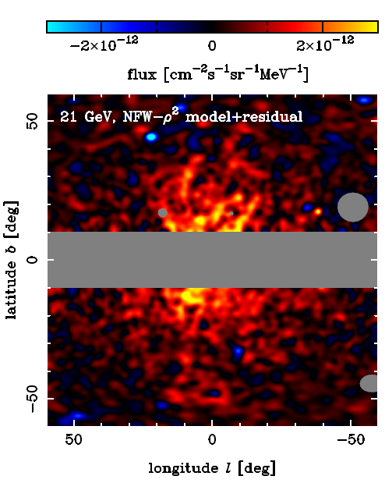
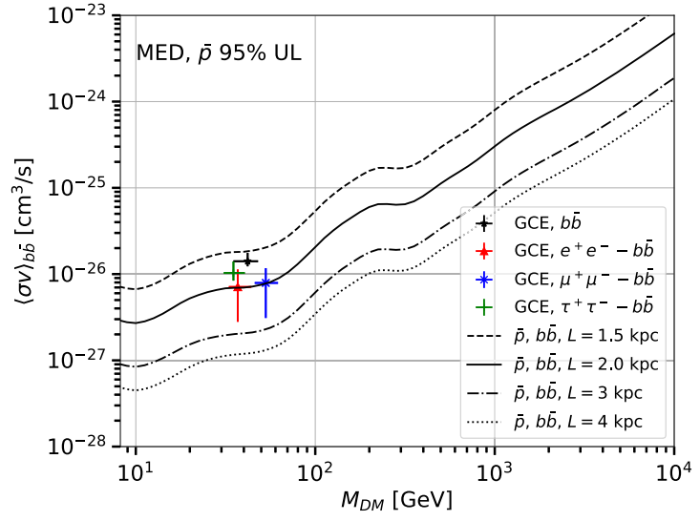
Halo-like excess in the GC region
Totani 2025
Di Mauro & Winkler, PR D 103, 123005 (2021)
Totani, JCAP11(2025)080

Slide 4
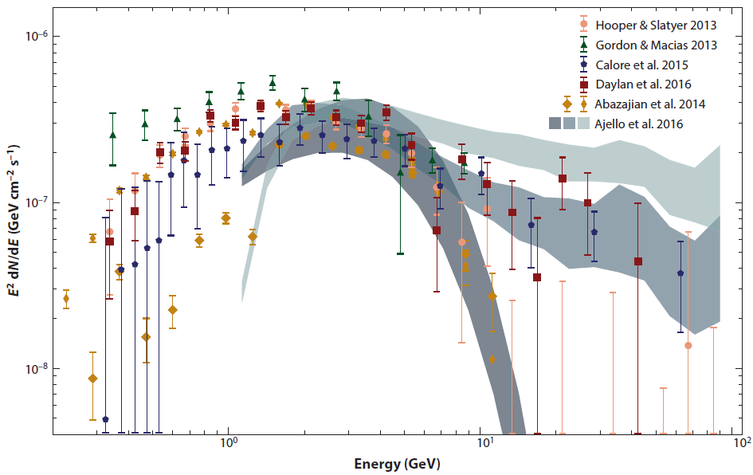
Features of the GC excess
Observed with high significance in Fermi-LAT data
SED peaks between 1-3 GeV (or 20 GeV [Totani])
Possible Explanations
  Emission from millisecond pulsars
    Too faint for LAT to detect as point sources
  Emission from Dark Matter annihilation
    Annihilation channels correspond to DM mass
Murgia, Annu. Rev. Nucl. Part. Sci. 70: 455–83 (2020)

Slide 5
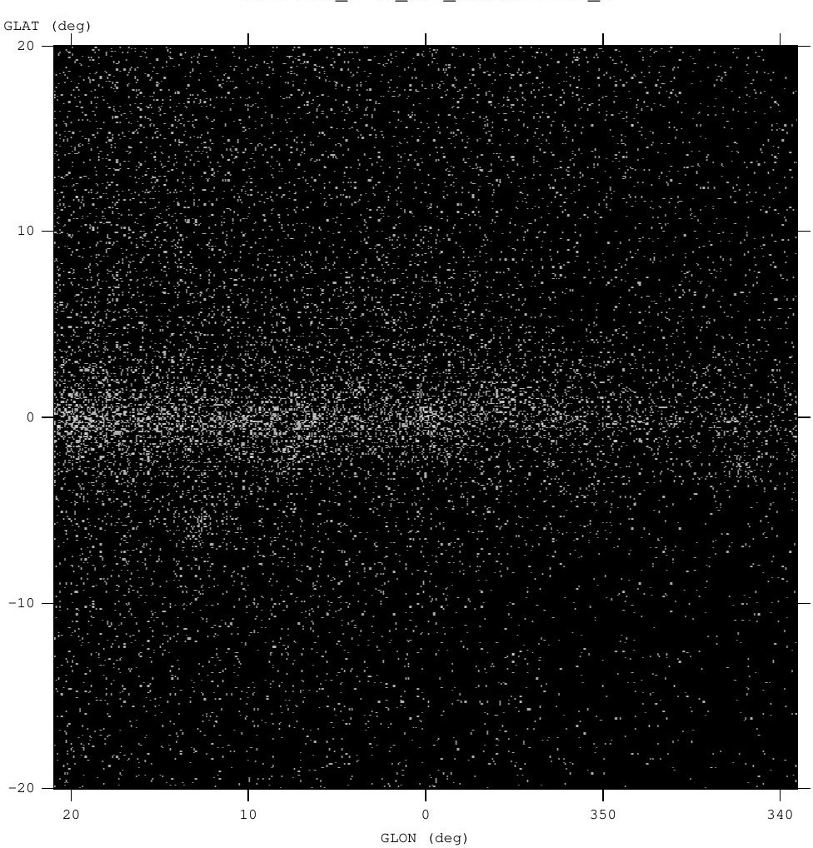
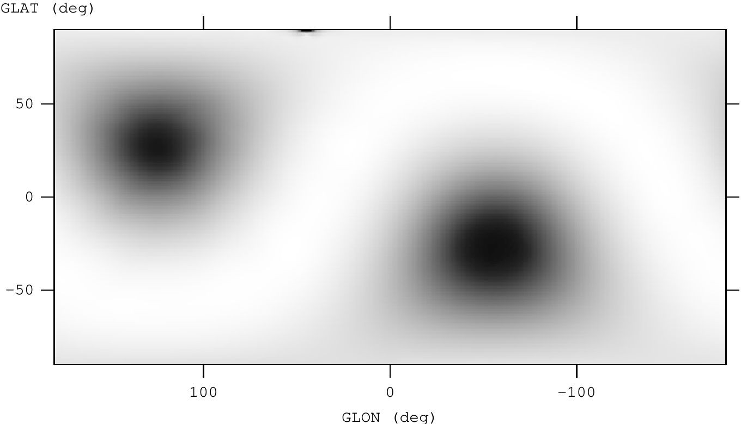
Integration With FermiPy
GLAT
CAL data is stored in ROOT files, LAT data is stored in FITS
3 CAL files must be added:
  CAL IRFs
  CAL counts cube
  CAL exposure cube
All 3 match their LAT counterparts in terms of binning and FITS headers so the comparison between CAL and LAT can be as direct as possible
GLON
1-10 GeV CAL counts map centered on GC
GLAT
GLON
CAL all-sky exposure map
https://fermipy.readthedocs.io/en/master/

Slide 6
Analysis
1– 10 GeV, 6 bins per decade
Time range: 2015 November 02 to 2023 July 11
ROI: 15° around source
GTAnalysis:
  gta.setup(): Data selection. For CAL this is used to make source maps
  Free the norm of all sources within 3° of the ROI center
  Free all parameters of the isotropic and galactic diffuse (gll_iem_v07) components as well as the source under study.
  gta.fit(): returns the best-fit SED parameters and the full covariance matrix

Slide 7
Analysis (Cont.)
Diagnostic plots can be generated after the fit
  Counts map
  Offset of data from source position in Galactic longitude and latitude.
Source position is set to 0
SEDs are plotted to check for consistency between Fermi-LAT and CALET
  Error bars do not include systematics

Slide 8
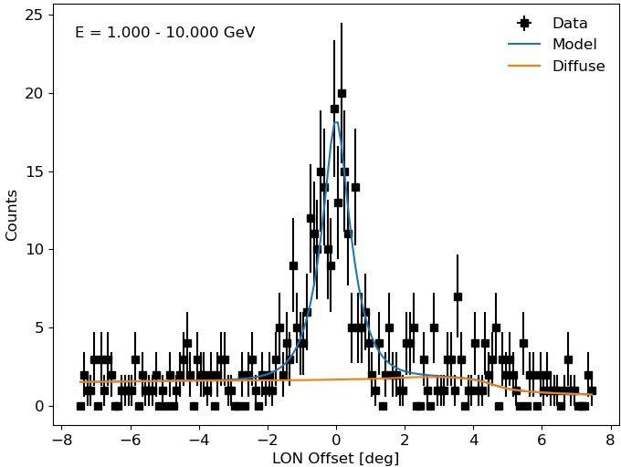
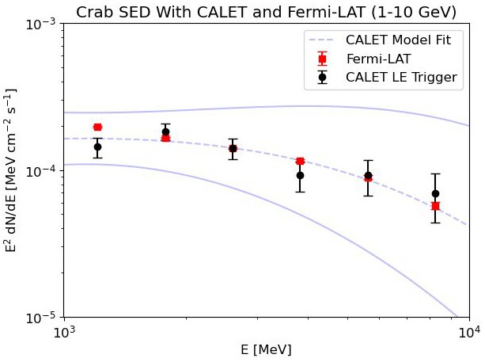
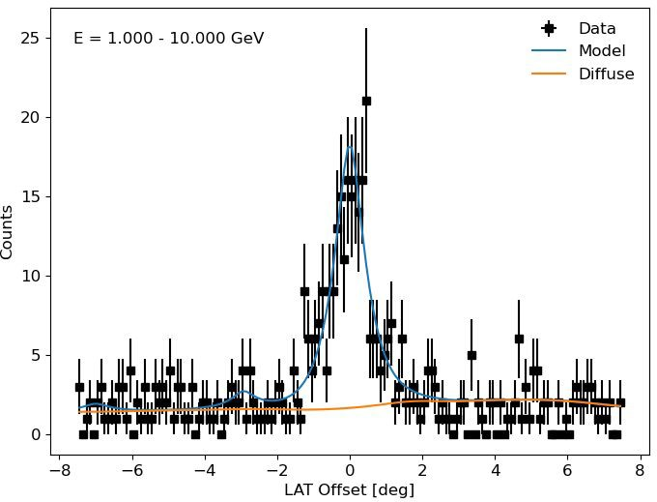
Crab
Preliminary
GLON
GLAT

Slide 9
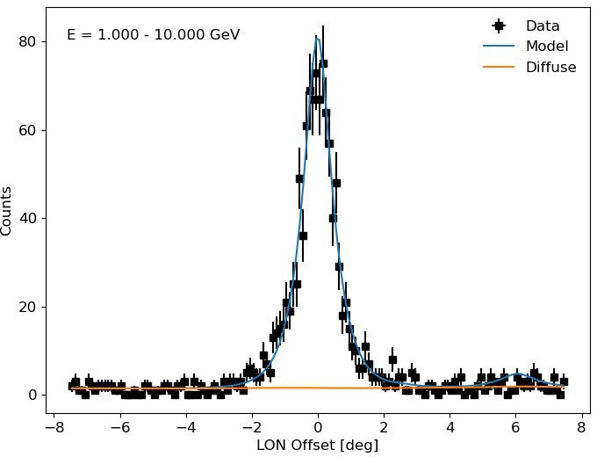
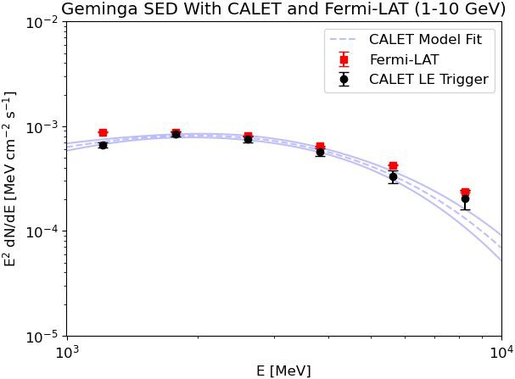
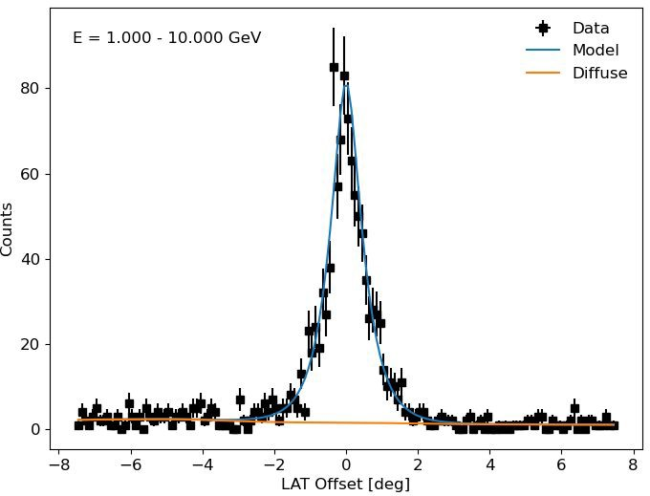
Geminga
Preliminary
GLON
GLAT

Slide 10
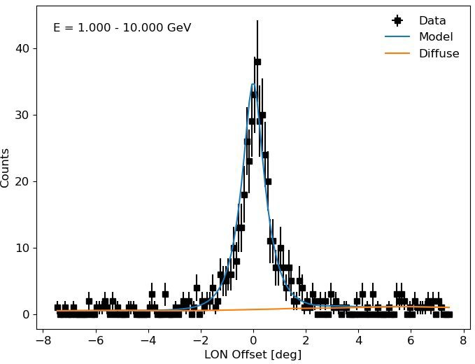
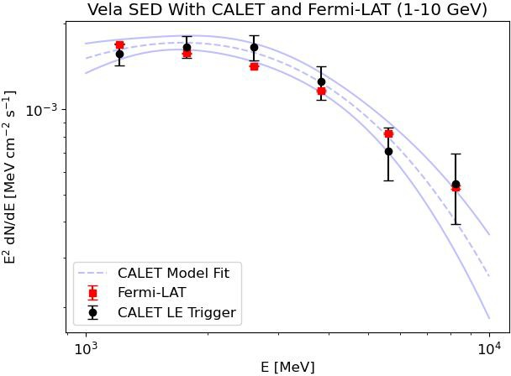
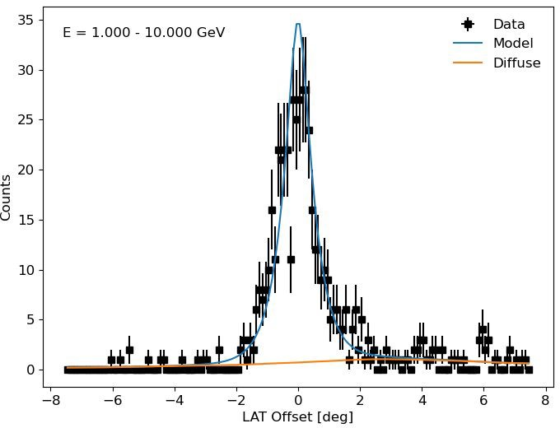
Vela
GLON
Preliminary
GLAT

Slide 11
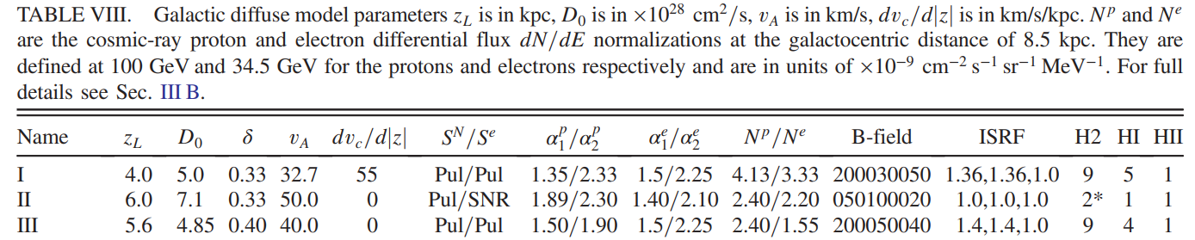
Progress Toward GCE Analysis
40°x40° ROI, 1-10 GeV, 8 bins/decade
Galactic diffuse emission model: Cholis et al. 2022 Model XLIX
…
…
Cholis et al., PR D 105, 103023 (2022)

Slide 12
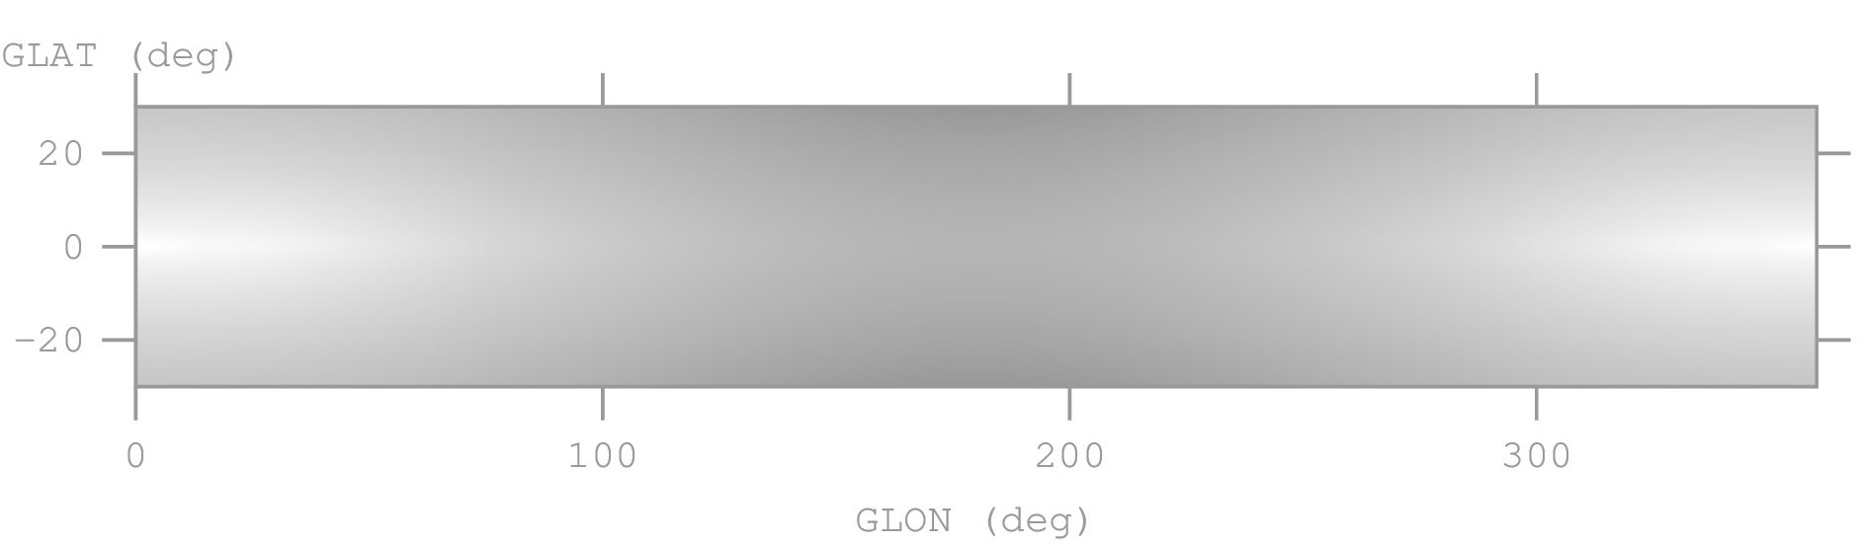
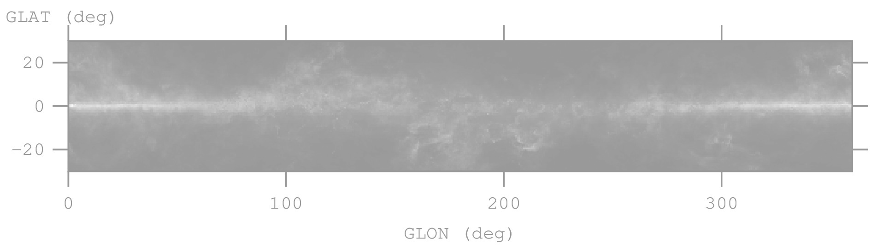
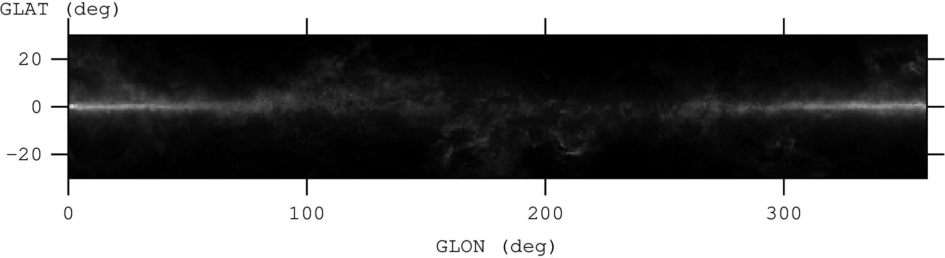
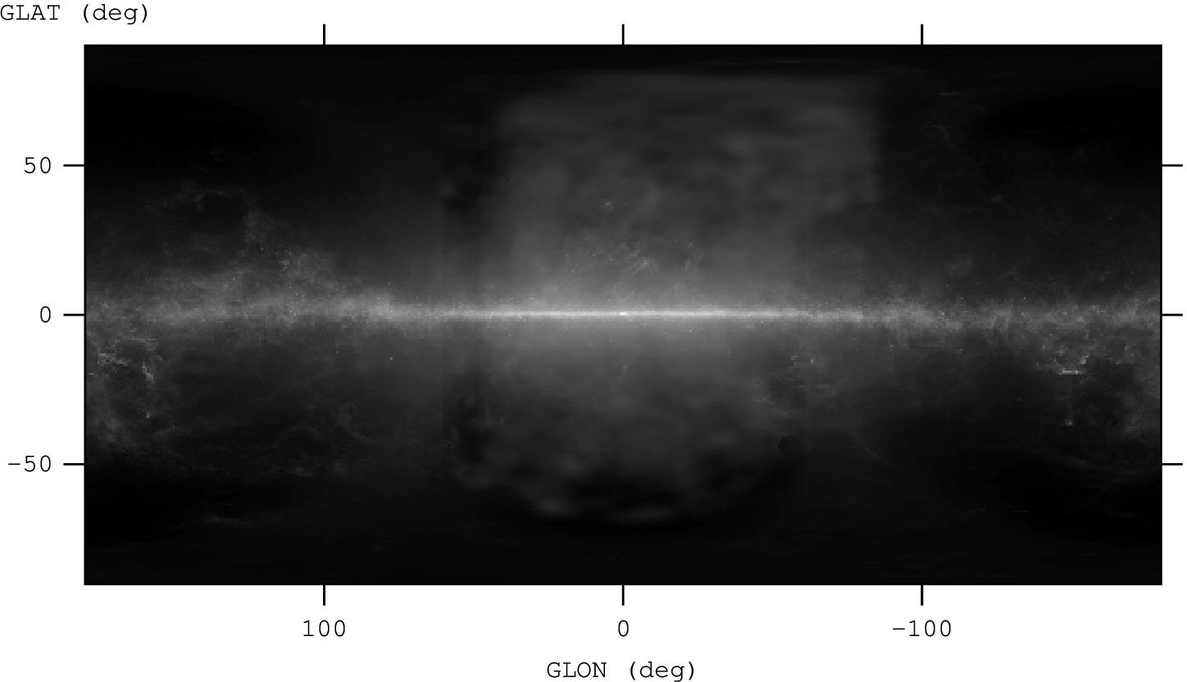
GDE Model
Cholis et al. 2022 Model XLIX
gll_iem_v07
(includes Fermi Bubbles)

Slide 13
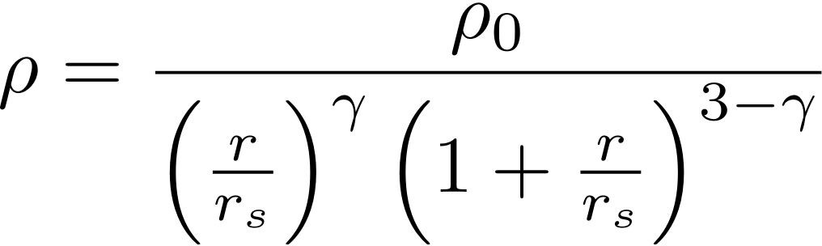
Progress Toward GCE Analysis
40°x40° ROI, 1-10 GeV, 8 bins/decade
Galactic diffuse emission model: Cholis et al. 2022 Model XLIX
GCE template based on generalized NFW profile
γ = 1.2, r_{s} = 20 kpc

Slide 14
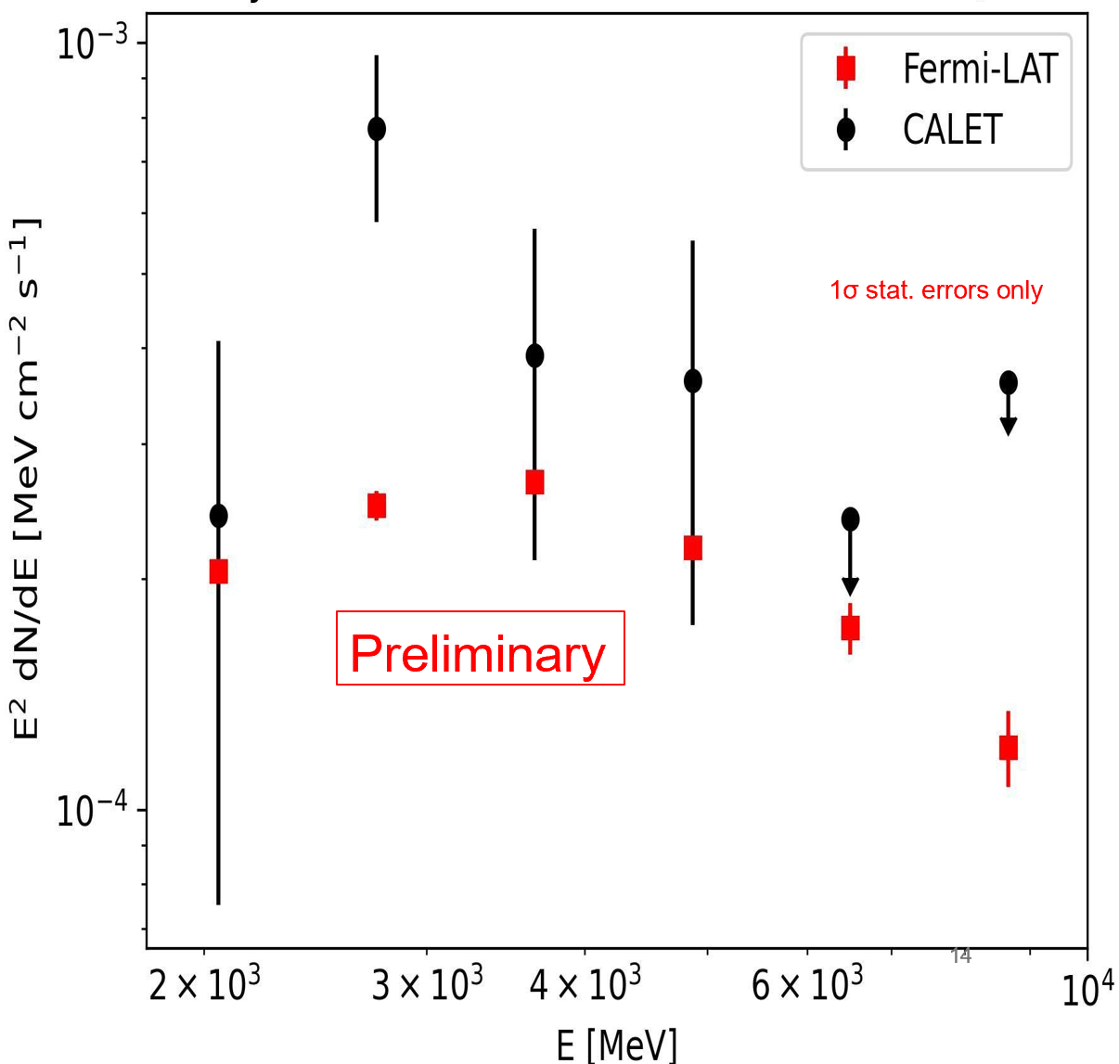
GCE SED with CALET & Fermi-LAT
2-10 GeV
Preliminary

Slide 15

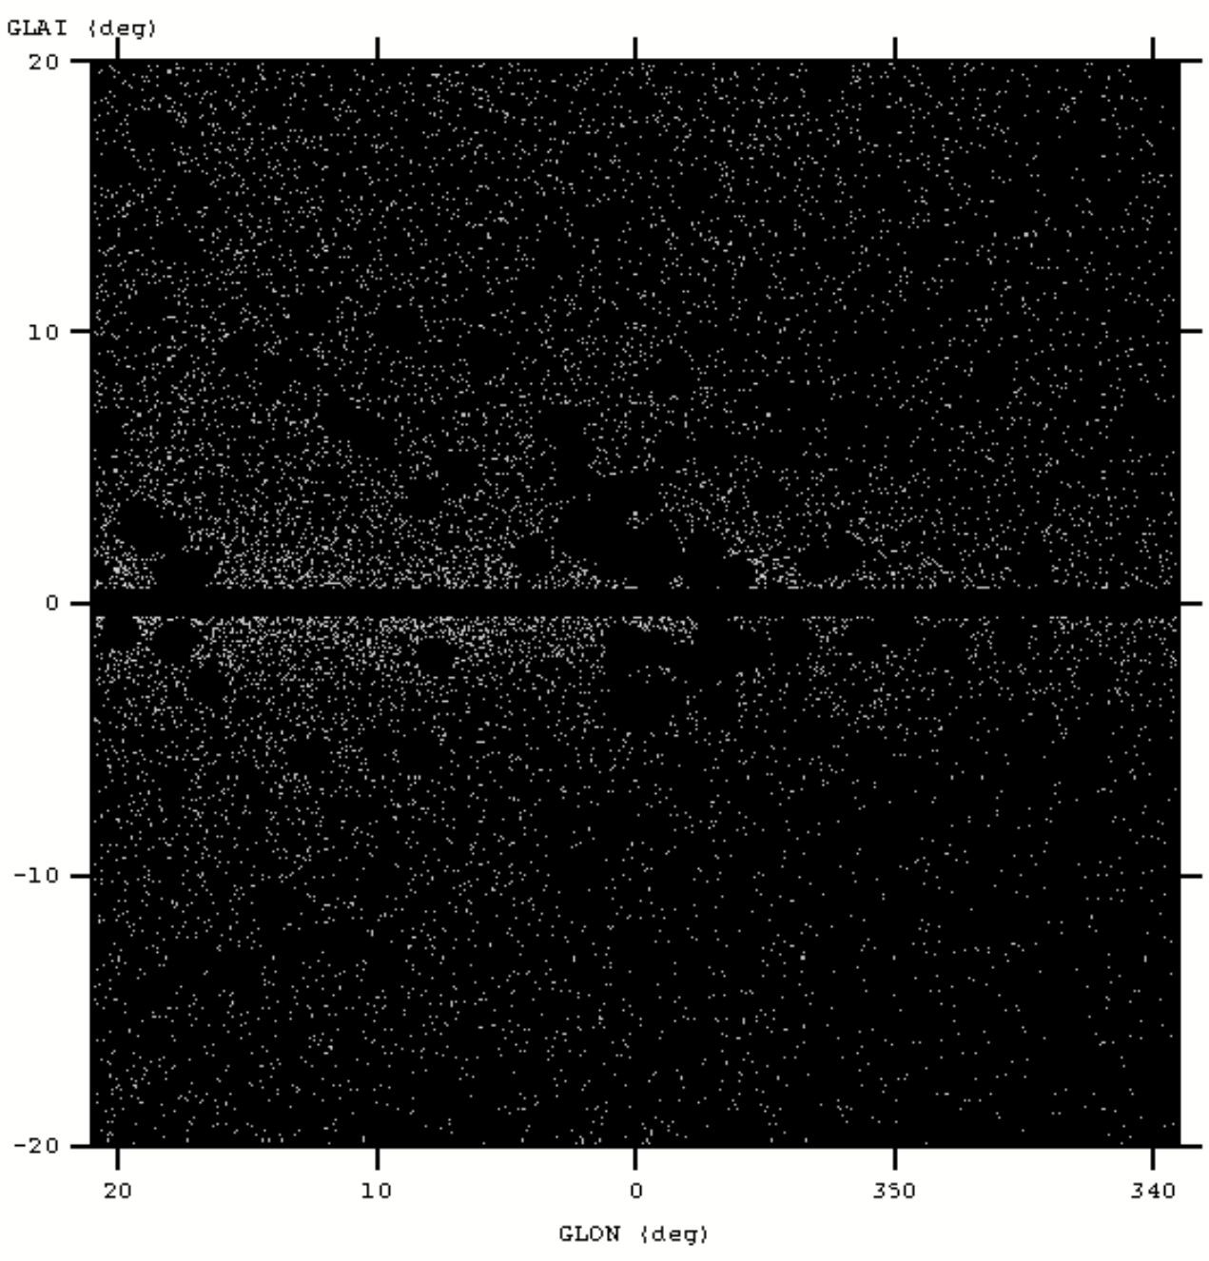
Progress Toward GCE Analysis (Cont.)
Developing mask of point sources and Galactic plane.
For comparison to Fermi GCE analysis and to compensate for CALET’s lower statistics, we choose to mask sources based on Fermi TS values:
  |b|< 1°
  0.3° point sources 25 ≤ TS < 49
  0.7° point sources TS ≥ 49
Procedure based on Zhong and Cholis Phys. Rev. D 109, 123017 and Alemanno et al. arxiv:2512.23458v1
CALET counts map 1-10 GeV unmasked (left) and masked (right)

Slide 16
Summary
CALET gamma-ray data analysis is successfully integrated into FermiPy
GCE analysis is underway
  Preliminary results are encouraging
  Mask development in progress
Acknowledgements:
Alex Reustle and Joe Asercion, FermiPy staff Miltos Michailidis, Stanford Postdoc

